Slide 1
Understanding Causal Inference
Using Python

Slide 2

Table Of Contents
Introduction
Sales Data set
Causal Inference
Conclusion

Slide 3

Introduction and Business Objective
In Business, the decision-makers require dependable strategies to accomplish business goals, whether they aim to increase revenue, profit, or any other indicator of business success. Nevertheless, both businesses and their external surroundings are highly intricate and challenging to assess, making it tough to foresee the outcomes of a specific managerial decision.
Recent advancements in the emerging field of causal modeling present significant progress that has the potential to revolutionize the realm of managerial decision-making. In contrast to the conventional "predictive" models commonly utilized in marketing, causal modeling techniques are employed to reliably uncover, depict, and analyze cause-and-effect relationships rather than mere correlations.

Slide 4
Basic Concepts:
STEPS:
Determine appropriate units
Identify the treatment/target unit along with a set of comparable units that form the donor pool.
Implement the intervention
Apply the intended treatment/intervention solely on the target unit.
Develop the model
Fit the model using data from the pre-intervention period to establish the synthetic control group.
Analyze the outcomes
Examine the fits before and after the intervention; the latter reveals the causal impact.
Treatment :
A 'treatment effect' is the average causal effect of a binary (0–1) variable on an outcome variable of scientific or policy interest.
Control:
With No Treatment
Confounders:
Confounders are variables that can impact both the dependent and independent variables, leading to a false association.
For instance, smoking is a confounder that can affect both alcohol consumption and the development of lung cancer.

Slide 5
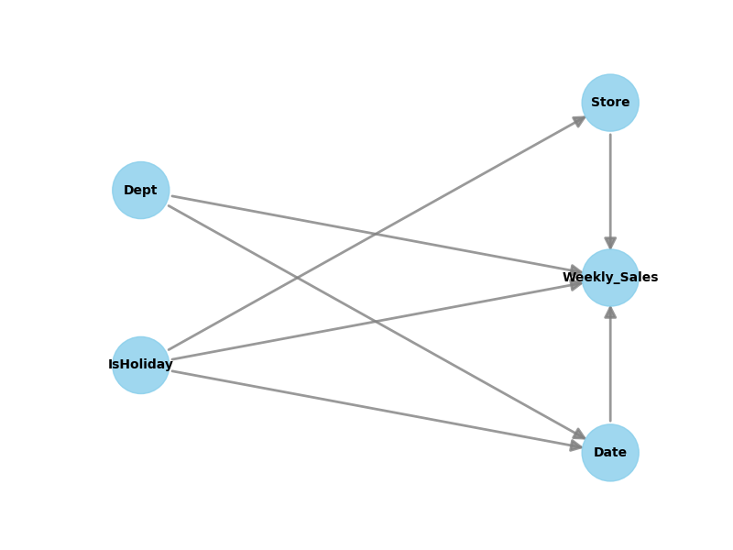
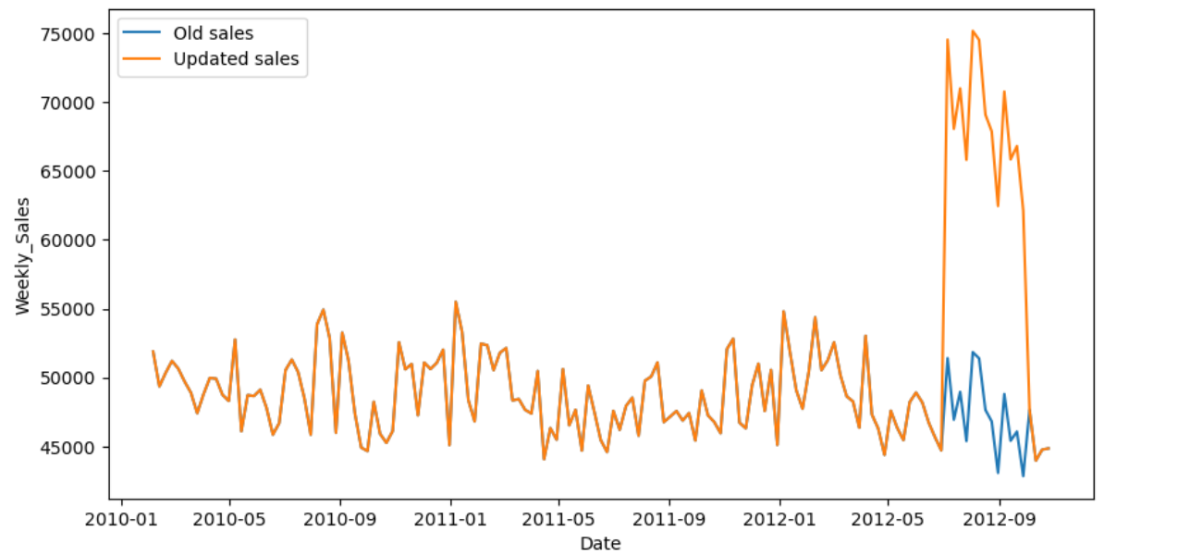
Sales DataSet
Causal Analysis
This dataset contains historical sales data spanning from:
February 5, 2010, to November 1, 2012.
The dataset includes columns such as:
Store (store number),
Dept (department number),
Date (week), Weekly_Sales (sales for the specified department in the specified store),
IsHoliday (indicating whether the week is a special holiday week).
Dataset: https://www.kaggle.com/datasets/manjeetsingh/retaildataset

Slide 6
OBSERVATIONS
1. **Actual**: This represents the actual observed data. In this case, the actual value is 63253.19, and the cumulative value (which could represent a total or aggregate) is 1075304.21.
2. **Prediction (s.d.)**: This section shows the predicted values along with their standard deviations. The predicted value is 48680.53, and the standard deviation associated with this prediction is 746.74. Similarly, the cumulative predicted value is 827569.08, with a standard deviation of 12694.61.
3. **95% CI**: This represents the 95% confidence interval for the predicted values. For the predicted value, the interval is [47177.77, 50104.94], and for the cumulative predicted value, it's [802022.08, 851784.02].
4. **Absolute effect (s.d.)**: This section shows the absolute effect of the intervention or event, along with its standard deviation. The absolute effect is calculated by subtracting the predicted value from the actual value. Here, the absolute effect is 14572.65, with a standard deviation of 746.74.
5. **95% CI**: This represents the 95% confidence interval for the absolute effect. It is given as [13148.25, 16075.42].
6. **Relative effect (s.d.)**: This section shows the relative effect of the intervention or event, expressed as a percentage, along with its standard deviation. The relative effect is calculated by dividing the absolute effect by the actual value and multiplying by 100. Here, the relative effect is 29.94%, with a standard deviation of 1.53%.
7. **95% CI**: This represents the 95% confidence interval for the relative effect. It is given as [27.01%, 33.02%].
8. **Posterior tail-area probability p**: This represents the probability of observing a result as extreme as or more extreme than the observed result under the null hypothesis (i.e., no causal effect). In this case, it's given as 0.0, suggesting strong evidence against the null hypothesis.
9. **Posterior prob. of a causal effect**: This represents the posterior probability of a causal effect, given the data. In this case, it's given as 100.0%, suggesting strong evidence in favor of a causal effect.
Posterior Inference {Causal Impact}
Average Cumulative
Actual 63253.19 1075304.21
Prediction (s.d.) 48680.53 (746.74) 827569.08 (12694.61)
95% CI [47177.77, 50104.94][802022.08, 851784.02]
Absolute effect (s.d.) 14572.65 (746.74) 247735.13 (12694.61)
95% CI [13148.25, 16075.42][223520.19, 273282.13]
Relative effect (s.d.) 29.94% (1.53%) 29.94% (1.53%)
95% CI [27.01%, 33.02%] [27.01%, 33.02%]
Posterior tail-area probability p: 0.0
Posterior prob. of a causal effect: 100.0%

Slide 7
Conclusion
If we analyze various business scenarios and explore the instances where causal models can be beneficial, we can gain valuable insights. We have laid down the essential principles of causal inference and concluded by highlighting some widely used Python packages for causal analysis.
The following packages offer extensive capabilities:
DoWhy: (Causal Inference - effect size: "Effect of X on Y")
2. EconML: Causal Discovery Algorithm For further information and guidance,
Please refer to the documentation available at: https://pywhy.org/dowhy/v0.10.
GitHub: https://github.com/ds-stratgic-work/Causal-Inference-using-Python.git

Slide 8


Thank You
dSights is a data tech specialist with a vision to create value through:
Outcome-Oriented AI
Fueled by
Innovative Experimentation

